Slide 1
Mathematical Olympiads
and their goals
Teachers College, Columbia University
New York, November 18-20, 2016
Vladimir Sharich / Шарич Владимир Златкович
sharich@mathschool.ru
«Foxford.ru» «MathSchool.ru» «Phystech-lyceum»

Slide 2
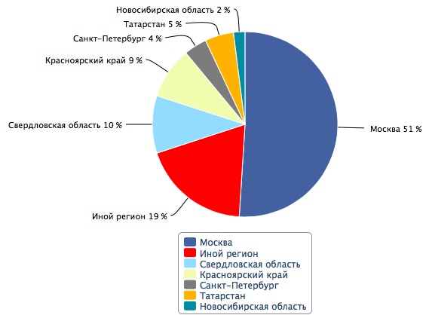
Mathematical Olympiads
University
admission
Science
Sport
Status

Slide 3
Plan
A brief history
Current crisis
Substantive crisis
Format crisis
Ethical crisis
Measures to meet the crisis
A special experience
Ways to overcome the crisis

Slide 4
A brief history
XV-XVIII century: One-vs-one
XIX century: Mass contests
XX century:
Town contests
National contests
World contests
XXI century: University admission contests (?!)
A brief history
Current crisis
Substantive crisis
Format crisis
Ethical crisis
Measures to meet the crisis
A special experience
Ways to overcome the crisis

Slide 5
Substantive crisis
Very few, almost none new ideas for the contest problems
Olympiads turned into a sport of combining standard ideas
Excluding real science from mathematical circles
A brief history
Current crisis
Substantive crisis
Format crisis
Ethical crisis
Measures to meet the crisis
A special experience
Ways to overcome the crisis

Slide 6
Substantive crisis
All-Union, 1962, grade 9 of 10: Given a square table NxN with odd N, its each cell containing ±1, for every horizontal and vertical row we calculate the product of the numbers in this row. Prove that the sum of obtained 2N numbers is not equal to 0.
All-Russian, 2015, grade 9 of 11: Given N>8 different non-negative numbers, each less than 1, with the property that for every 8 numbers there exists 9th such that the sum of these nine numbers is integer, determine how many numbers could there be at least?
A brief history
Current crisis
Substantive crisis
Format crisis
Ethical crisis
Measures to meet the crisis
A special experience
Ways to overcome the crisis

Slide 7
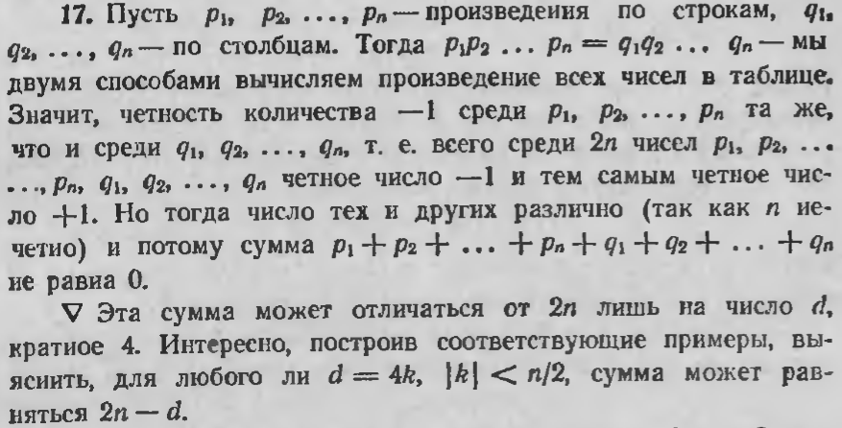
Substantive crisis
All-Union, 1962, grade 9 of 10: Given a square table NxN with odd N, its each cell containing ±1, for every horizontal and vertical row we calculate the product of the numbers in this row. Prove that the sum of obtained 2N numbers is not equal to 0.
A brief history
Current crisis
Substantive crisis
Format crisis
Ethical crisis
Measures to meet the crisis
A special experience
Ways to overcome the crisis

Slide 8
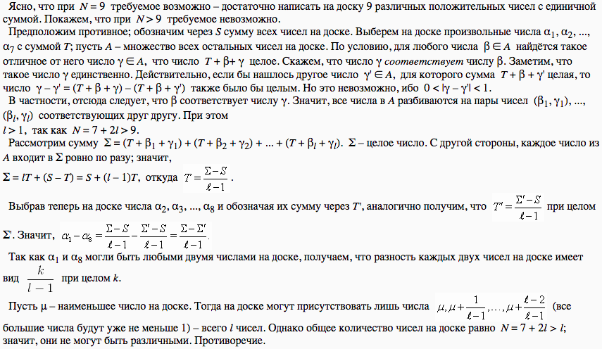
Substantive crisis
All-Russian, 2015, grade 9 of 11: Given N>8 different non-negative numbers, each less than 1, with the property that for every 8 numbers there exists 9th such that the sum of these nine numbers is integer, determine how many numbers could there be at least?
A brief history
Current crisis
Substantive crisis
Format crisis
Ethical crisis
Measures to meet the crisis
A special experience
Ways to overcome the crisis

Slide 9
Format crisis
Contests instead of entrance examinations
Special courses for solving Olympiad problems
Parents start to train their children too early
A brief history
Current crisis
Substantive crisis
Format crisis
Ethical crisis
Measures to meet the crisis
A special experience
Ways to overcome the crisis

Slide 10
Ethical crisis
The profit from the winning goes not only to the participant, but also to his coach and his school, thus impacting the relations
A brief history
Current crisis
Substantive crisis
Format crisis
Ethical crisis
Measures to meet the crisis
A special experience
Ways to overcome the crisis

Slide 11
Measures to meet the crisis
Inviting researchers, organising workshops
A brief history
Current crisis
Substantive crisis
Format crisis
Ethical crisis
Measures to meet the crisis
A special experience
Ways to overcome the crisis

Slide 12
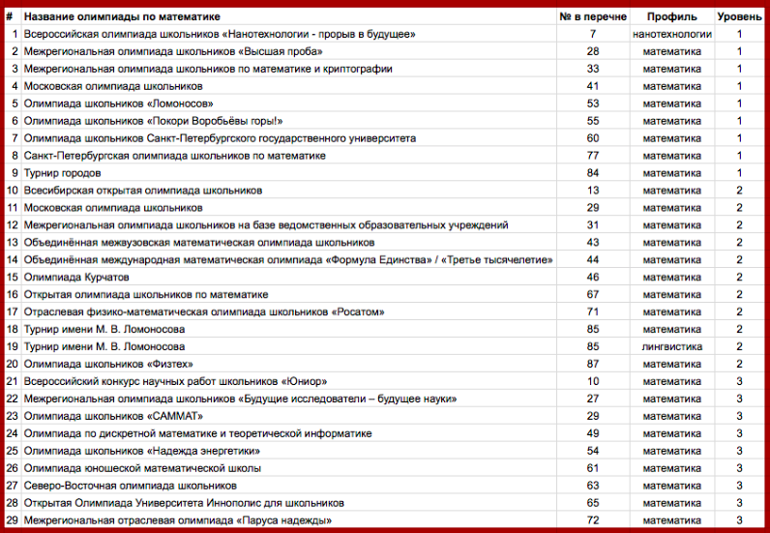
Measures to meet the crisis
Arranging the List and assigning the levels
A brief history
Current crisis
Substantive crisis
Format crisis
Ethical crisis
Measures to meet the crisis
A special experience
Ways to overcome the crisis

Slide 13
Measures to meet the crisis
Dividing the scores, having the right to choose the school
A brief history
Current crisis
Substantive crisis
Format crisis
Ethical crisis
Measures to meet the crisis
A special experience
Ways to overcome the crisis

Slide 14
Mathematical all-around
A special experience
Individual
and team
competitions
Popular
lectures
Everyone
is a winner
Experimental
round
Algebra & NT
Geometry
Combinatorics & logics
Mathematical race
Team Olympiad
Every member of the methodological board delivers
a lecture on his favourite topic
Most of the participants
gain awards
in one of the competitions
New forms of competitions
Arbitrary teams

Slide 15
Ways to overcome the crisis
Cooperation between researchers and Olympiad managers
Understanding the true sense of Olympiads
Reducing the role of the school and the teacher
A brief history
Current crisis
Substantive crisis
Format crisis
Ethical crisis
Measures to meet the crisis
A special experience
Ways to overcome the crisis

Slide 16
Thank you for your attention!
Vladimir Sharich / Шарич Владимир Златкович
sharich@mathschool.ru
«Foxford» online school http://foxford.ru
«Mathematical school» society http://mathschool.ru
«Phystech-lyceum» school http://ftl.name

Slide 17
QUESTIONS
How to bring new fresh ideas to competition problems and make them more like science?
What is the real meaning and purpose of mathematical competitions?
What kind of recognition should be implemented for teachers and schools?

